Slide 1
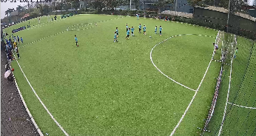
/cam1’ affect zoom to /cam1 while /cam1’ keep full screen
Camera 1
HKV
/cam1’ (Internet)
Client 1
/cam1 (LAN)
Web Editor
pos/zoom
Di Chuột
Camera 0
OBS
Client 0
HKV
/cam0’ (Internet)
/cam0 (LAN)

